Slide 1
C++
Md. Abdur Rahman
Senior Computer Scientist
Centre for Advanced in Research in Sciences (CARS)
University of Dhaka

Slide 2
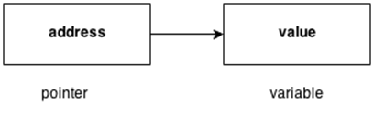
C++ Pointers
The pointer in C++ language is a variable, it is also known as locator or indicator that points to an address of a value.

Slide 3
Advantage of pointer
Pointer reduces the code and improves the performance, it is used to retrieving strings, trees etc. and used with arrays, structures and functions.
We can return multiple values from function using pointer.
It makes you able to access any memory location in the computer's memory.

Slide 4
Usage of pointer
Dynamic memory allocation
In c language, we can dynamically allocate memory using malloc() and calloc() functions where pointer is used.
Arrays, Functions and Structures
Pointers in c language are widely used in arrays, functions and structures. It reduces the code and improves the performance.

Slide 5
Symbols used in pointer
Symbol | Name | Description
& (ampersand sign) | Address operator | Determine the address of a variable.
∗ (asterisk sign) | Indirection operator | Access the value of an address.

Slide 6
Declaring a pointer
The pointer in C++ language can be declared using ∗ (asterisk symbol).
int ∗ a; //pointer to int
char ∗ c; //pointer to char

Slide 7
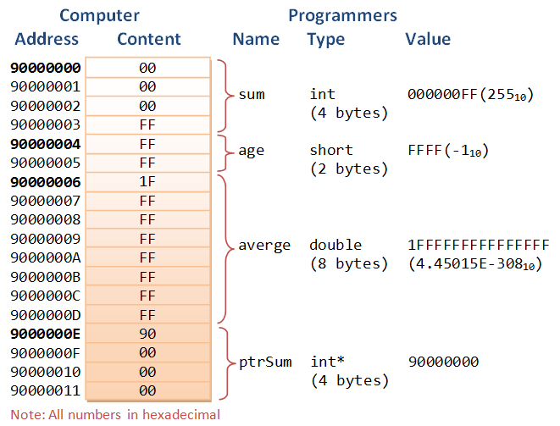

Slide 8
Pointer Example
#include<iostream>
using namespace std;
int main()
{
int number = 30;
int* p;
p = &number;
cout <<"Address of the number is: " << &number <<endl;
cout <<"Address of p variable is: " << p <<endl;
cout <<“Value of p variable is: "<<*p<<endl;
return 0;
}

Slide 9
Swap 2 numbers without using 3rd variable
#include<iostream>
using namespace std;
int main()
{
int a = 20, b = 10, *p1 = &a, *p2 = &b;
cout<<"Before swap: *p1 = "<<*p1<<" *p2 = "<<*p2<<endl;
*p1 = *p1 + *p2;
*p2 = *p1 - *p2;
*p1 = *p1 - *p2;
cout<<"After swap: *p1 = "<<*p1<<" *p2 = "<<*p2<<endl;
return 0;
}

Slide 10
When calling a function with an argument, a new variable is instantiated internally and assigned the value passed in the function call.
Any modifications to the value inside the function are performed to this new variable; the variable that was invoked with the function call is unchanged.
#include<iostream>
using namespace std;
void setValueToFive(int x)
{
std::cout << &x << "\n";
x = 5;
}
int main()
{
int x = 3;
setValueToFive( x );
std::cout << "The value of x is " << x << ", setValueToFive() did not modify x.\n";
}

Slide 11
A function can be written to perform the same task but instead accept a pointer as the argument.
This lowers the memory footprint of the program. Unnecessary duplicate variables aren't created. The function can modify the variable's value directly.
void setPointerValueToFive(int *x)
{
*x = 5;
}
int x = 3;
setPointerValueToFive( &x );
std::cout << "The value of x is " << x << ", setPointerValueToFive() modified x.\n";
// Outputs: The value of x is 5, setPointerValueToFive() modified x

Slide 12
We can pass a variable by reference by passing in a variable, and defining the function's parameter like int &x.
#include<iostream>
using namespace std;
void setValueToFiveWithReference(int& x)
{
x = 5;
}
int main()
{
int x = 3;
setValueToFiveWithReference( x );
std::cout << "The value of x is " << x << ", setPointerValueToFive() modified x.\n";
// Outputs: The value of x is 5, setPointerValueToFive() modified x
}

Slide 13
Null Pointers
A pointer with 0 or NULL, i.e., it points to nothing. It is called a null pointer.
int * iPtr = 0; // Declare an int pointer, and initialize the pointer to point to nothing
cout << *iPtr << endl; // ERROR! STATUS_ACCESS_VIOLATION exception
int * p = NULL; // Also declare a NULL pointer points to nothing
return 0;

Slide 14
References (or Aliases) (&)
int number = 88; // Declare an int variable called number
int & refNumber = number; // Declare a reference (alias) to the variable number
// Both refNumber and number refer to the same value
cout << number << endl; // Print value of variable number (88)
cout << refNumber << endl; // Print value of reference (88)
refNumber = 99; // Re-assign a new value to refNumber
cout << refNumber << endl;
cout << number << endl; // Value of number also changes (99)
number = 55; // Re-assign a new value to number
cout << number << endl;
cout << refNumber << endl; // Value of refNumber also changes (55)

Slide 15
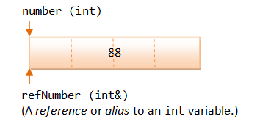
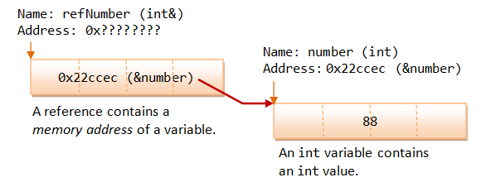
How References Work?

Slide 16
References vs. Pointers
Pointers and references are equivalent, except:
A reference is a name constant for an address. You need to initialize the reference during declaration.
int & iRef; // Error: 'iRef' declared as reference but not initialized
Once a reference is established to a variable, you cannot change the reference to reference another variable.

Slide 17
/* References vs. Pointers (TestReferenceVsPointer.cpp) */
int number1 = 88, number2 = 22;
int * pNumber1 = &number1; // Explicit referencing
*pNumber1 = 99; // Explicit dereferencing
cout << *pNumber1 << endl; // 99
cout << &number1 << endl; // 0x22ff18
cout << pNumber1 << endl; // 0x22ff18 (content of the pointer variable - same as above)
cout << &pNumber1 << endl; // 0x22ff10 (address of the pointer variable)
pNumber1 = &number2; // Pointer can be reassigned to store another address
// Create a reference (alias) to number1
int & refNumber1 = number1; // Implicit referencing (NOT &number1)
refNumber1 = 11; // Implicit dereferencing (NOT *refNumber1)
cout << refNumber1 << endl; // 11
cout << &number1 << endl; // 0x22ff18
cout << &refNumber1 << endl; // 0x22ff18
//refNumber1 = &number2; // Error! Reference cannot be re-assigned
// error: invalid conversion from 'int*' to 'int'
refNumber1 = number2; // refNumber1 is still an alias to number1.
// Assign value of number2 (22) to refNumber1 (and number1).
number2++;
cout << refNumber1 << endl; // 22
cout << number1 << endl; // 22
cout << number2 << endl; // 23

